Slide 1

Enhancing Productivity: Strategies for Optimizing Employee Efficiency in Workplaces
Team A: Zihao Li, Boxuan wang, Kaiji Zhen

Slide 2

Project Overview
Our team is collaborating with a food outlet named Shake Smart that specializes in health-centric offerings like shakes, smoothies, sandwiches, and fruit bowls. As they gain traction in the health and wellness sector, our role is to significantly boost their operational efficiency and productivity.

Slide 3
The Purpose of Project
Customized Employee Scheduling
Cost Reduction and Demand Fulfillment
Please see more detail under the slide in the note
Notes:
Cost Reduction and Demand Fulfillment: The project aims to lower operational costs while efficiently meeting daily sales demands and customer needs.
Customized Employee Scheduling: Focusing on creating personalized schedules for employees, taking into account variations in weather, monthly sales trends, and other dynamic factors.

Slide 4
Who Cares About Our Project?
The Client – Shake Smart
Industry Peers and Competitors
Potential Investors and Partners

Slide 5

Formulating Our Model/Optimization Problem

Slide 6

Model Formulation Overview
Shake Smart operates with a unique business model that typically requires only 3 to 6 staff members on duty during each shift. The production process of its products is akin to an assembly line – a sequence of simple yet repetitive tasks. This streamlined approach is central to the company's efficiency but also presents a unique challenge in terms of staffing.
To avoid unnecessary labor costs while maintaining high service standards, Our group had help Shake Smart to implemented a covering model for staff scheduling. This model is rooted in a data-driven approach, utilizing historical data on daily product demand to optimize the daily work schedule. The primary goal is to ensure that customer demand is met without incurring excessive labor costs.

Slide 7

Optimization Structure
Objective: Minimize employee cost.
Decision Variables: Shift arrangement for employees.
Constraints:
Total working hour for each employee must below 40 hours per/week
Total working people for each day should among 3 to 6
The real time people need should smaller than time need for making
Each shift should have at least one leader

Slide 8
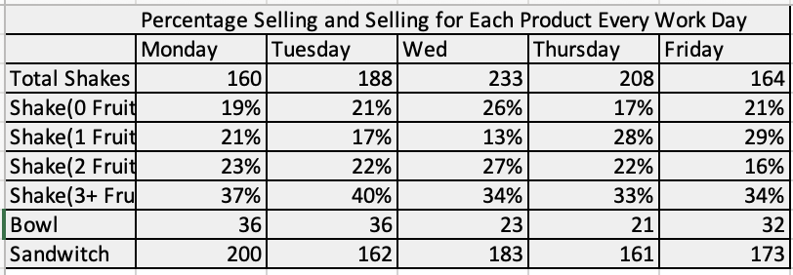
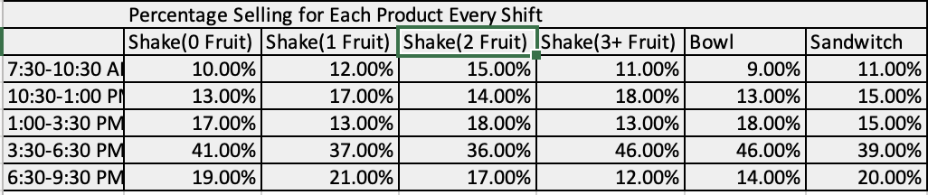
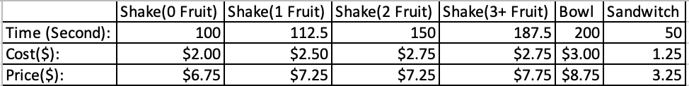
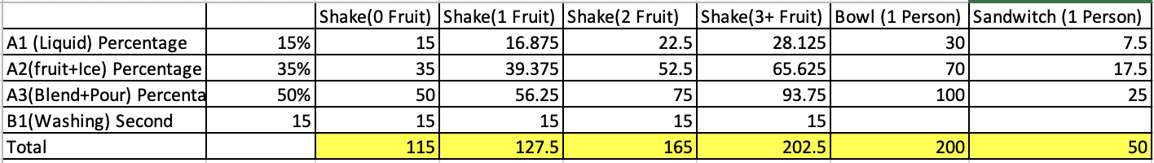
Inputs: Historical data
Product selling situation per shift, employee efficiency and time requirement for making each product

Slide 9
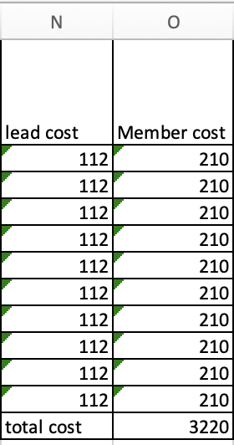
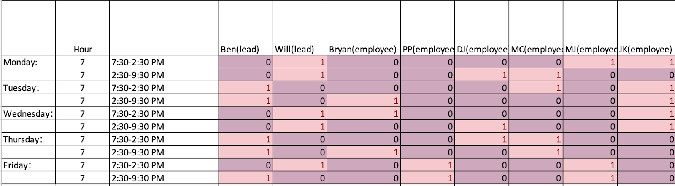
Output
Shift arrangement for each employee(each week) and Labor cost in each shift.

Slide 10

Key Milestone Calculations
Total Recommended Production Time
Individual Employee Work Time
Efficiency Gains in Teamwork
Optimization Model for Staffing
Please see more detail under the slide in the note
Notes:
Total Recommended Production Time: Using the production time for each product, we calculate the total recommended production time. This is essential to determine how long it would take to meet the daily demand.
Individual Employee Work Time: We then divide the total recommended production time by each employee's work efficiency to estimate the time it would take for an individual employee to complete the tasks.
Efficiency Gains in Teamwork: Recognizing the assembly line nature of the work, we factor in efficiency gains when teams of more than three people work together, resulting in reduced production time.
Optimization Model for Staffing: Finally, we use constraints such as the work time being less than the recommended production time and staff limitations to optimize the model. This helps in calculating the minimum personnel cost while ensuring productivity and efficiency.

Slide 11

Key Assumptions of Our Project
Consistent and Varied Employee Efficiency
Variable Daily Product Demand
Please see more detail under the slide in the note
Notes:
Consistent and Varied Employee Efficiency: We assume that each employee's work efficiency remains constant but varies among individuals. This includes the assumption that leaders generally exhibit higher average work efficiency compared to other staff members.
Variable Daily Product Demand: It's assumed that the demand for each product differs across weekdays. However, for a given weekday, the demand is roughly consistent from week to week. This variation in daily demand forms the basis for our optimized staffing model.

Slide 12

Our Achievement
We achieved a significant breakthrough by using historical data to create the most effective staffing schedules. This approach allowed us to match staff levels to customer demand patterns, ensuring efficient service during peak times while avoiding the cost of excess staff during quieter periods. This strategic scheduling not only met customer needs but also played a crucial role in minimizing costs and maximizing profits.

Slide 13

Using Our Model

Slide 14

Interface and Functionality
Our model in Excel is thoughtfully segmented into various parts, each clearly labeled for ease of use. Users can interact with these distinct sections to input or edit data as needed. Changes made in these areas are directly reflected in the final data compilation. The real power of our model comes into play on the 'Analysis' page, where Solver is employed to derive an accurate staffing schedule. This integration allows for a seamless and efficient process, from data entry to obtaining optimized scheduling solutions.

Slide 15

Model in Action Case Study/Example Overview
Imagine a scenario where Shake Smart has many staff available. Our model helps determine the optimal staffing configuration based on historical sales data. It considers the varying efficiency levels of different employees to create a customized schedule. For instance, if past records show a high demand on Friday evenings, our model will recommend scheduling the most efficient staff during that period, ensuring customer demand is met efficiently. This targeted approach enables us to adapt staffing to actual needs, enhancing both service quality and cost-effectiveness.

Slide 16


Benefits and Impact
Our model predicts a weekly savings of $1,904 in employee costs by adjusting staff numbers from a fixed six per shift to a flexible 3-6, based on demand. This approach effectively reduces labor expenses while meeting customer needs.

Slide 17

Navigating Through Challenges
Description: When we are running the model, because the model is too complex, the model's running time is too long, resulting in an error. Impact: We spent a lot of time simplifying the model and trying to run it. Resolution Strategy: After continuously simplifying the model, it finally ran successfully and obtained the desired results.
Please see more detail under the slide in the note
Notes:
Description of the Challenge: During the model's execution phase, we encountered significant difficulties due to its complexity. The intricate design of the model resulted in excessively long run times and, ultimately, errors that disrupted the process.
Impact of the Challenge: This complexity forced us to spend considerable time simplifying the model. We had to continuously iterate and attempt to run the model, which was a time-consuming and intricate process.
Resolution Strategy: Our persistence in simplifying the model paid off. After numerous iterations and modifications, we successfully streamlined the model to a point where it could run effectively. This led to achieving the desired results, demonstrating the importance of balancing complexity with functionality in model design.

Slide 18

Scope and Boundaries
Our model, limited by Excel Solver's capacity of 200 variables, is ideal for small businesses with fewer employees. For larger operations, a Python-based model would be more suitable due to Excel's constraints on handling complex, large-scale staffing needs.

Slide 19

Potential Enhancements and Expansions
If we had additional time, we plan to develop a Python version of our program for optimizing larger staff numbers and detailed shift schedules. This would also include using advanced regression techniques for more accurate demand forecasting.

Slide 20


